Slide 1



Maturing IT governance practices through effective PPM change management
Kiron D. Bondale, PMP – Solution Q Inc.
Sandro Gentile – Carleton University
June 8, 2011

Slide 2
Agenda
What is PPM & why pursue it?
Symptoms & causes of PPM initiative failure
Myths & guiding principles
Functional management
Project leaders & team members
Tips
Carleton University IT case study

Slide 3
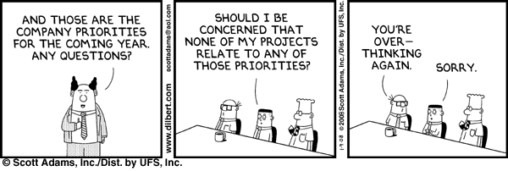
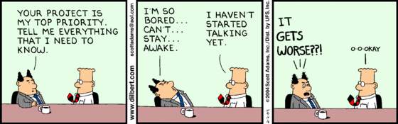
This never happens, right?

Slide 4
How about this?
A VIP lobbies for an IT project based on inflated assessment of expected benefits & minimal (or no) evaluation of risk
It gets approved and launched
Project benefits are never realized & VIP is never held accountable

Slide 5
Why pursue PPM?
Too many projects, too few staff?
Unproductive multi-tasking?
Unable to justify resource augmentation or project prioritization?
Improve predictability of project outcomes?
Evolve IT beyond “order taking” mode?

Slide 6
What is PPM?
Doing the right projects
Strategic approach to managing project investments with the objective of maximizing realized business value
A risk-balanced approach to investment decision making
It is a behavioral shift from optimizing individual projects to optimizing the sum of many projects

Slide 7
PPM initiative failures - Symptoms & causes
Cultural disconnects or resistance?
Too bureaucratic procedures or complex tools?
Behaviors that don’t change?
Lack of tangible benefits?
Lack of process compliance or enforcement?
= all symptoms of ineffective change management

Slide 8
Myths & misconceptions
If you build it, they will come
Everyone will follow the new procedures because they are just common sense
Management knows that these things take time to deliver value
We can enforce accountability with the new practices
Our staff resist change on principle

Slide 9
Guiding principles
Visible executive sponsorship & commitment
Whole lifecycle communication
Expect, identify, and manage resistance
Address compliance issues constructively
“Walk a mile in the shoes”
“Show me the money”

Slide 10
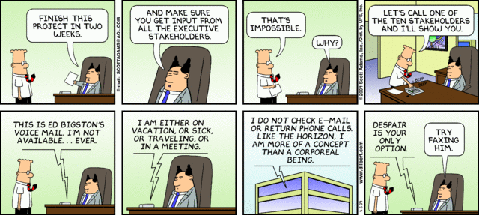
Executive sponsorship
What NOT to look for in an executive sponsor!

Slide 11
Functional management – Perceived threats
Increased accountability
Reduced ability to play politics
Increased effort spent on resource administration

Slide 12
Functional management – Potential selling points
Easier to process resource requests
Evidence to justify project prioritization or resource augmentation
Increased visibility into project status and decision making
Increased ability to motivate staff
= Increased gratification for work done

Slide 13
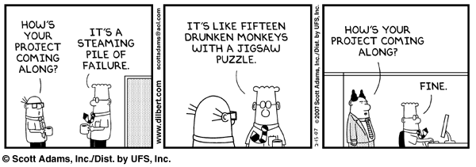
Project leaders & team members – Perceived threats
Counter to stereotypical North American “maverick” culture
New procedures = more work
“Big Brother” or micro-management
No more “custom” project status updates…

Slide 14
Project leaders & team members – Potential selling points
Improved project predictability
Reduced status reporting effort
(Hopefully) focused & reduced workload
Less effort spent firefighting = more time spent on completing project work
Reduced multi-tasking = less effort wasted on context switching
= Increased gratification for work done

Slide 15
Tips
Include at least one resource from each impacted role
Tie individual performance objectives to the initiative
Coaching is better at addressing compliance issues than enforcement
Reward early adopters

Slide 16
Tips
Avoid “big bang”
Focus on the least amount of change required to achieve short term business objectives
Don’t collect data that you are not planning to use (and share)

Slide 17
Tips
Actively solicit and incorporate feedback
Provide simple “PM 101” training for all impacted staff
Make sure you have process coaches!
Leverage tools appropriately to automate new procedures & provide explicit procedural guidance on use of these tools

Slide 18
Carleton University Case Study

Slide 19
Carleton University
About Carleton
Why pursue a PPM Initiative?
Our Approach
The Achievements
What’s next?
Lessons Learned
Management Reports

Slide 20
About Carleton University IT
Ottawa Ontario
26,000 registered students
2,000 staff
1,600 instructors
97 Information Technology staff (CCS) *
4 staff in the Project Office
PM methodology for at least 7 years

Slide 21
Carleton University IT metrics
Number of IT Internal projects
10 Active and 14 Proposals
Number of user community projects
15 Active and 9 Proposals **
Number of project resources
H.I.T. team comprises 15 people

Slide 22
Why pursue a PPM initiative?
The PM reasons
Too many projects, not enough resources
Every project is critical… to someone
The stealth projects…what do they become
The zombie projects
The failed projects

Slide 23
Why pursue a PPM initiative?
The Corporate reasons
Lack of overall prioritization
Priority within the silos
First past the gate
No picture of all IT initiatives
Impossible to do Resource Management in IT

Slide 24
What approach was taken?
Develop a project proposal process
In IT first
Prioritize and categorize
Authorize for Charter development (project initiation)
Flesh out the issues in IT
Introduce PPM to the Community
Change the composition and mandate of the ISSC
Introduce the proposal and governance at ISSC

Slide 25
What was achieved?
Projects align with corporate or IT strategies
Inventories of proposals and active projects are available to stakeholders/ senior management
IT has a MUCH better picture of upcoming projects
Priorities are known and agreed to
Input to IT resource planning

Slide 26
What’s next?
Focus on improving Resource Management
More up front analysis work
One central inventory of projects and proposals
Connect the Corporate and IT strategic Planning processes

Slide 27
Lessons Learned
It’s a change management process
It is a sloooooow process
Change from project details to strategic
Need to do lots of educating
The why and benefits
Constant communication
IT Governance at the Senior level
Start in IT Org with IT projects

Slide 28
Report Examples

Slide 29
 |  |  | H.I.T Team Resource |  | Planned May(%) | Planned Jun(%) | Planned Jul(%)
Davis, Patricia - [Fulltime Resource] |  |  |  | Total | 128 | 94 | 77
 |  |  |  | Availability | (28) | 6 | 23
 | Project Time |  |  | Total | 117 | 74 | 57
 |  | SCP045A - Faculty Electronic Recruiting System |  | Total | 54 | 27 | 21
 |  | SCP029 - Reengineering Grad Admissions & Funding Processes |  | Total | 10 | 10 | 11
 |  | SCP035 - Travel & Expense Management |  | Total | 48 | 31 | 20
 |  | SCP030 - Teaching Assistant Management |  | Total | 5 | 6 | 5
 | Non-Project Time |  |  | Total | 10 | 20 | 20
 |  |  | Operational support & maintenance | Total | 10 | 20 | 20
Gillam, Brian - [Fulltime Resource] |  |  |  | Total | 168 | 160 | 269
 |  |  |  | Availability | (68) | (60) | (169)
 | Project Time |  |  | Total | 168 | 160 | 218
 |  | SCP039 - Banner Document Management System (BDMS) |  | Total | 84 | 80 | 175
 |  | SCP029 - Reengineering Grad Admissions & Funding Processes |  | Total | 63 | 60 | 38
 |  | Student Systems Support AD |  | Total | 21 | 20 | 5
 | Non-Project Time |  |  | Total | 0 | 0 | 50
 |  |  | Annual leave/ time off | Total | 0 | 0 | 50

Slide 30
In Process Projects - Schedule Health
CIO
2009/ 2010 | June | July | Aug | Sept | Oct | Nov | Dec | Jan ‘11 | Feb ‘11 | Mar ‘11 | Apr ‘11
Green | 64% (7) | 45% (5) | 30% (4) | 46% (6) | 64% (9) | 75% (9) | 40% (4) | 54% (7) | 58% (7) | 34% (4) | TBD
Yellow | 36% (4) | 27% (3) | 62% (8) | 54% (7) | 36% (5) | 25% (3) | 50% (5) | 38% (5) | 42% (5) | 33% (4) | TBD
Red | 0 | 27% (3) | 8% (1) | 0% | 0% | 0% | 10% (1) | 8% (1) | 0 % | 33% (4) | TBD
On Schedule | Behind | Way Behind (30%)

Slide 31

Questions?
kbondale@solutionq.com
sandro_gentile@carleton.ca

